Slide 1



Slide 2

Time (est) | Session
11:00 | Introduction
11:30 | Elements of a Profile
12:00 | Business Suite Tour
12:30 | Break
12:45 | How and What to Post
1:30 | Practicing Stories
2:00 | Break
2:15 | Ads and Analytics
2:45 | Moving Forward
3:00 | Open Discussion or Groups

Slide 3

Microphone – You're in control. If you want to add to the conversation or ask a question, please turn on your microphone!
Video camera – Feel free to leave it on, unless your internet starts acting up. Turning your camera off can help your internet.
Cell phone – Is it charged? If not get it plugged in near you, please.
If you lose connection, just re-login and we will get it restarted.
Today's sessions will be a combination of PowerPoints, handouts, and hands-on training in internet browsers and in apps.

Slide 4

Let's introduce ourselves to each other!
Say your name
Introduce your business
Your business industry/industries
How long have you been in business?
What are you hoping to learn from today's session?
Notes:
Start by introducing yourself -
Dezaree Stack
Owner of Stack Strategies
Stack Strategies is a digital marketing agency who completes projects and educates business owners. We've been in business officially for a little over a year.
From today's session... I am hoping to see this class learn social media consitency and how to showcase themselves in the all best ways
* Cheers cup of coffee now *

Slide 5

Please visit www.stack-strategies.com/social-media-handouts

Slide 6
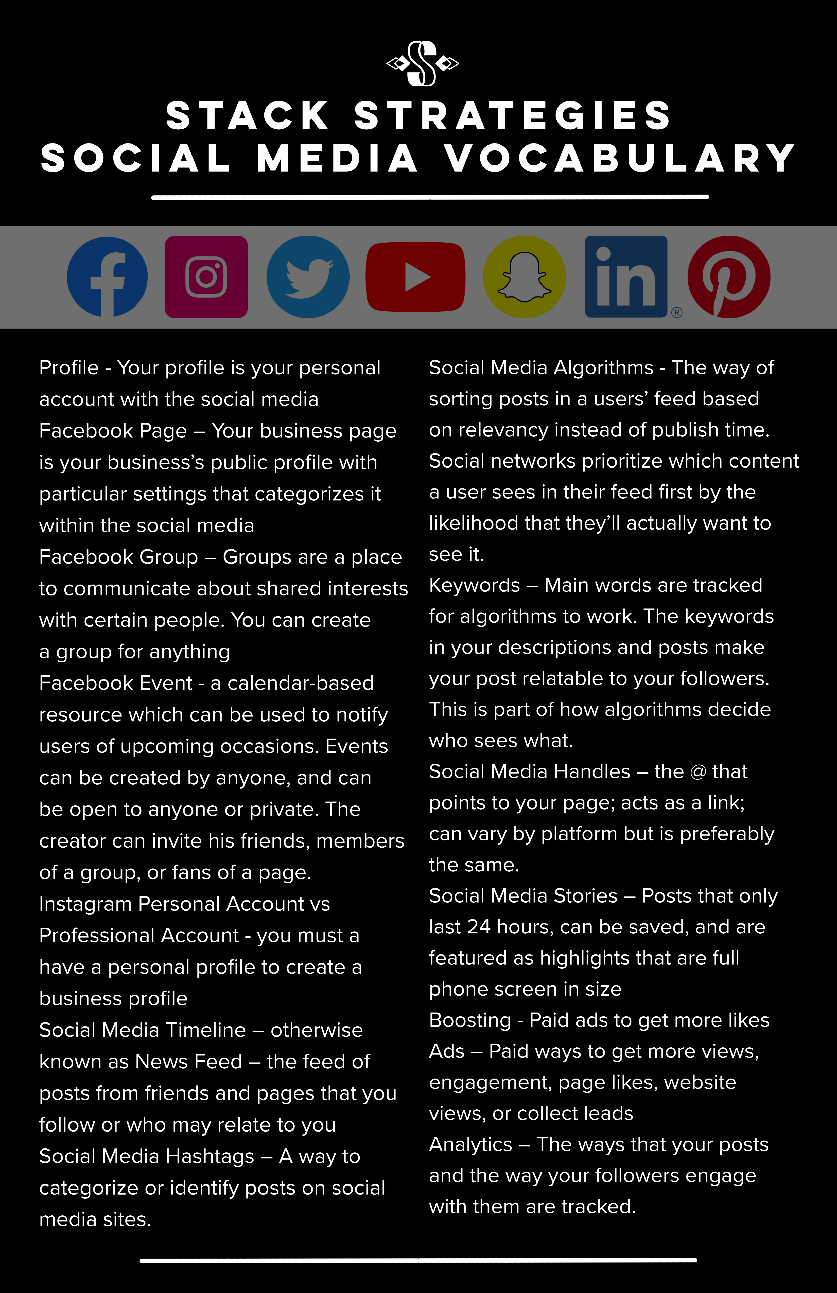

What social media platforms are you on?
Do you have professional pages on these?
Any questions about any social terms?

Slide 7

User Time Spent
On average, FB users are on 38 minutes per day.
On average, Instagram users are on 28 minutes per day.
The average Pinterest session lasts for about 5 minutes.
Active Users
FB has 2.7 billion monthly users
Instagram has 1 billion monthly users
200 Million users visit one business daily
Pinterest has 416 million monthly users
Sourced from www.stryvemarketing.com

Slide 8

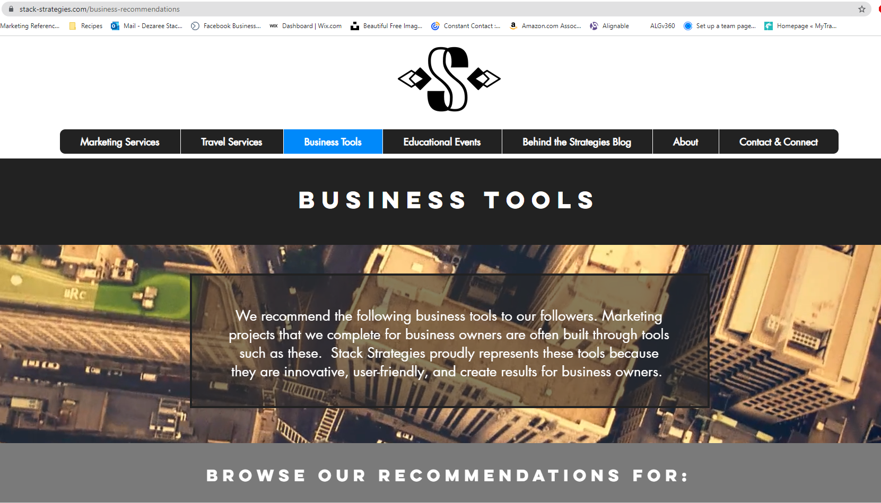
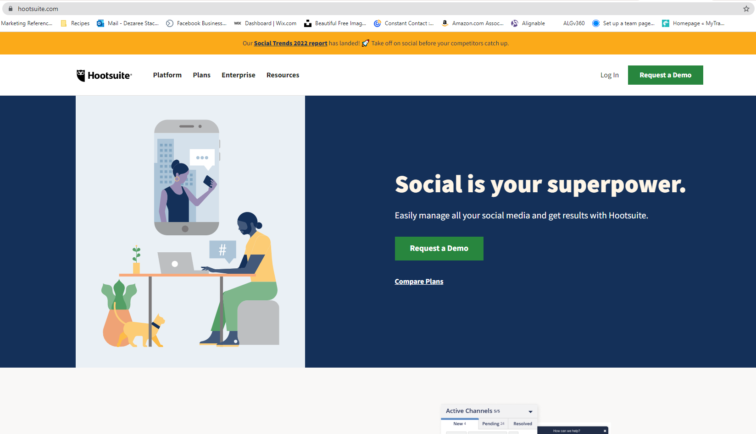
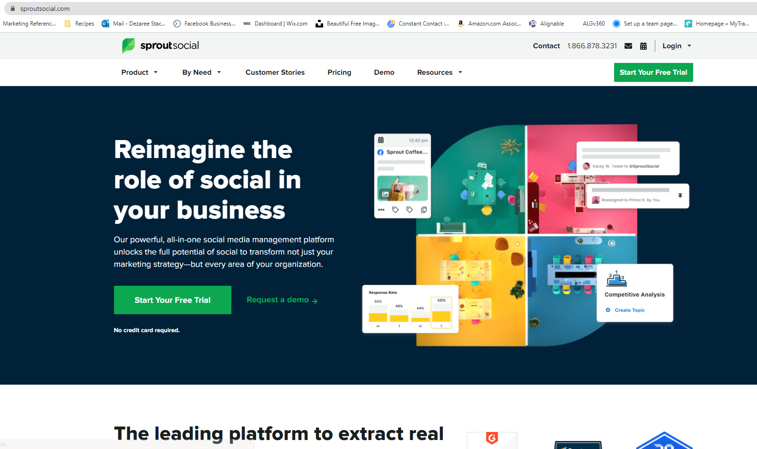
If you want to manage all pages in one place, you should possibly consider a third-party post scheduler or manager. Otherwise, you'll need manually post on each individual platform!

Slide 9

Let's visit www.facebook.com to explore a page.

Slide 10


Auditing Your Page
Profile Pic – headshot with logo OR logo
Cover Photo(s)
About
  Description
  Likes
  Website
  Phone
  Email
  Hours
  Categories
  Other Socials
Tabs

Slide 11


Everyone follow along from your browser!
Interact with your page as your company
Interact with your page as a visitor (from your personal profile)
Now let's try on your phone FB app
Go on FB app
View your page
Find "View as" button

Slide 12


Does everyone have an Instagram for professionals?
Is that in addition to your personal pages?
Are you signed into both pages?
Double-clicking on icon to switch pages
Switching from Profile page

Slide 13

Let's visit www.business.facebook.com

Slide 14

Business Suite is a free tool that lets you manage your Facebook, Instagram and Messenger accounts in a single place, saving you time and simplifying how you connect with customers.
Whether you’re using it on desktop or mobile, Business Suite makes it easy to view notifications and respond to messages quickly. You can also create or schedule posts, stories and ads for your business, and you’ll find helpful insights to optimize your efforts as you go.
1. Let's visit the website and bookmark it to your computer
2. Let's download the app from your phone's app store
Notes:
Dashboard
Notifications/Inbox
Posts / Stories
Planner
Ads
Insights
More Tools
Page Settings
Page Roles

Slide 15

15 minutes

Slide 16

Combining Words, Pictures, Graphics, and Videos to make content

Slide 17

Let's get out a blank sheet of paper, and please write your business name in the center of it.
Next, we're going to start a timer for five minutes.
During this time, write any images, subjects, topics, products, specialities, niches, expertise areas, or anything else that relates to your business, brand and how people think of you and your business.

Slide 18
TIME IS UP!
Okay – cross out some ideas if you need to narrow it in.
Let's share some of our concept ideas that relate to our business and brands amoungst the class.

Slide 19

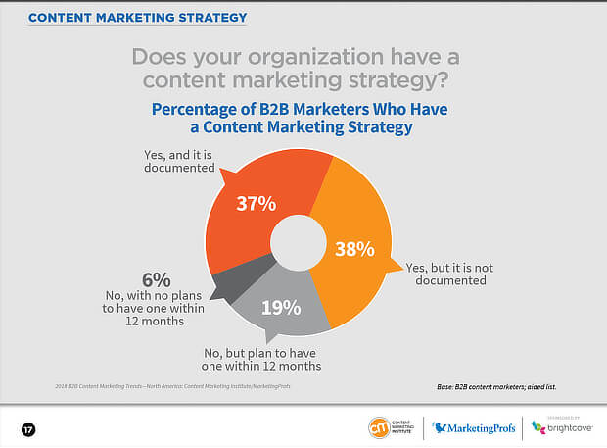
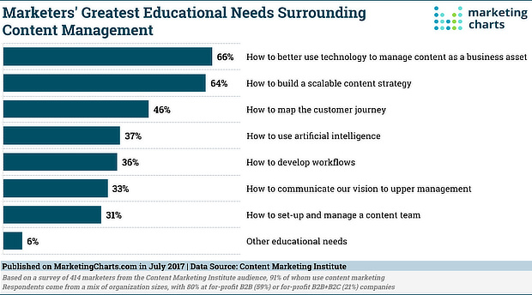

Slide 20

Start with a brainstorm
Start with a brainstorm
2. Let's turn that brainstorm into a content chart
3. After we have a chart, we will turn that into a post plan.

Slide 21
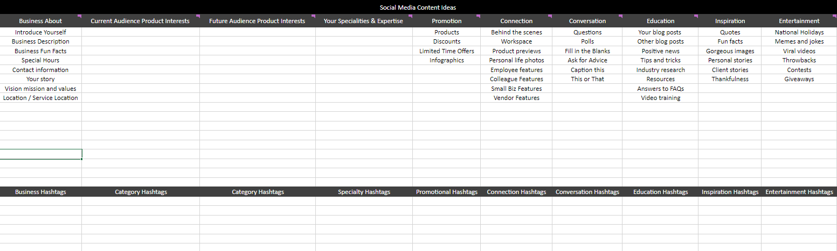
Go to the resource page and download the next resource... the content chart!

Slide 22

Let's add some information into each column of the chart
that relates to you and your business:
Use your brainstorm to add ideas to the chart
Think about your business's goals and mission
Consider your current audience
Answer to what you want to start doing next
Define your products and services
List what you're an expert at
We'll take 5 minutes to add to your personal charts now
Notes:
Remind the class to save the chart as they made changes!

Slide 23
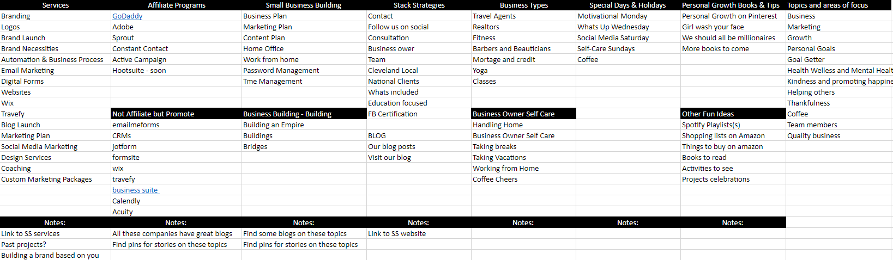
Here is Stack Strategies' content chart:
Notes:
Remind the class to save the chart as they made changes!

Slide 24

Homework: Adding hashtags to your content chart!
Follow in order of your content columns
Make at least one hashtag per topic/idea
It's smart to add 3-4 per cell
Example:
#stackstrategies #stackstrategiesblog #ssblog #stackstrategiesmarketing #ssmarketing
Notes:
Remind the class to save the chart as they made changes!

Slide 25
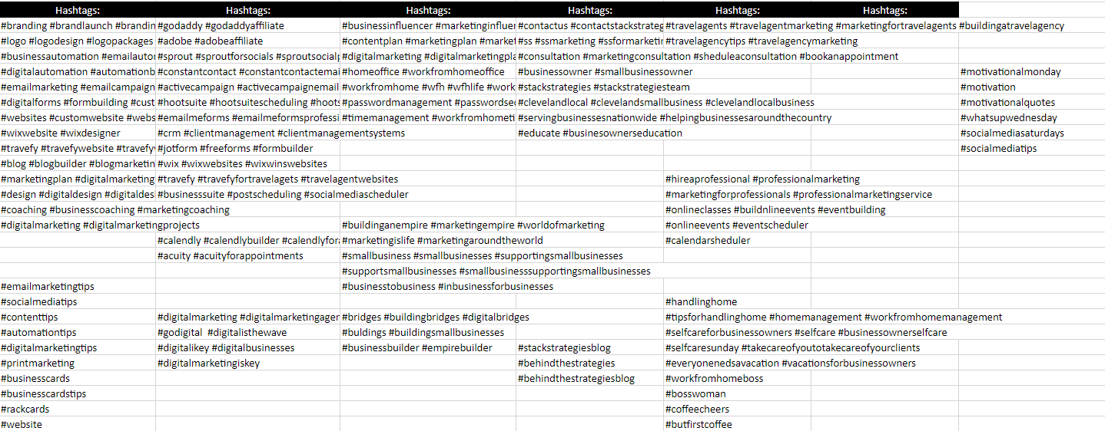
Here is Stack Strategies' hashtags:
Notes:
Remind the class to save the chart as they made changes!

Slide 26
How many times do you want to post a week?​
Do you want to post different content on different platforms?
4-6 Posts | 8-12 Posts | 12-15 Posts
1-2 posts - business product/service 1 post – hashtag or holiday 1 post – connection or conversation 1 post – business about 1 post – educational | 2-3 posts – business product /services 1-2 posts – specialty expertise 1-2 posts – holiday or hashtag 1-2 posts – connection or conversation focused 1-2 posts – educational 1 post – business about (optional) 1 post – inspirational | 3 posts – business product or services 2-3 posts – educational 2 posts – specialty expertise 2 posts – connection or conversation 1-2 posts – holiday or hashtag 1-2 posts – website links 1 post – business about 1 post – inspirational
Notes:
Remind the class to save the chart as they made changes!

Slide 27

Now that we know what topics we want to post about and how often, we must collect content to create posts with.
There are six types of content we can use for posts. Using varying content types creates interest.
1. Word Content
2. Pictures
3. Graphics
4. Videos
5. Links
6. Hashtags
Notes:
Remind the class to save the chart as they made changes!

Slide 28

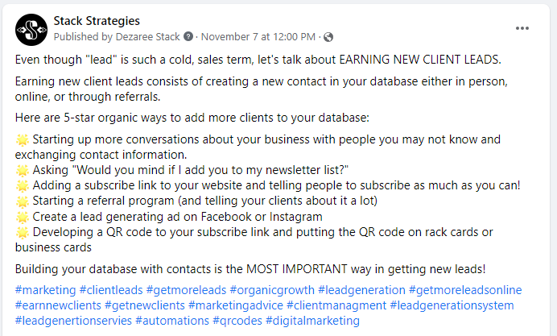
Your words mean everything. The first sentene means the most. The last something should give your readers an action or idea.
Shorter Content: Words don’t have to be lengthy and take up your entire content. They can be short, snappy phrases, slogans, statistics, questions to generate interest, and more.
Lengthy Content: Build a story in your social media post with your words. Break up your paragraphs. Consider making a list. Remember, not everyone knows who you are or what you do, so write from that perspective.
Lists: Words can be broken up into bulleted lists using emojis for bullets to appear more unique and eye-catching.

Slide 29

Pictures will come into play the most when creating content for Instagram and Pinterest. Pictures can come from multiple sources. When finding pictures, be sure to:
Organize your own photos. Using your own photos is a great way to make posts personalized and help clients get to know you better. Backup your pictures regularly through the Cloud or on an external drive.
Use free stock photos. There are tons of great resources to access stock photos you can use for free. Look at sites like Pexels and Unsplash. Many bloggers have more recommendations if you choose to research even more.
Use paid stock photos. If you don’t find what you’re looking for on free sites, even more sites have larger libraries available for purchase. Canva, Adobe, and Sprout all have paid libraries of stock photos to access.

Slide 30


Graphics are a combination of words, pictures, and icons that are branded for a business. Graphics take a bit more work as you will craft them as opposed to simply save and posting a photo. When creating graphics:
Quick Tips:
Use bright, eye-catching colors in your business’ color scheme to draw attention
Use contrast in your graphic
Create a variety of layouts for your graphics. In other words, don't do the same thing every time.
Brand every graphic. In the above example, notice the link at the bottom. This tells clients exactly where to go.
When creating graphics, try to achieve the above balance of images with text blocks.

Slide 31

Videos can be anything from pre-recorded videos on platforms like YouTube, live videos on Facebook and Instagram live, or a series of short, brief videos on Instagram stories. Consider these tips when it comes to creating videos for your content:
Lighting. Good lighting is crucial to looking professional and appealing. Invest in a ring light for a professional, polished look or set up in a room with plenty of natural light.
Tone and Facial Cues. To make sure you’re getting the right message across, practice your tone and facial expressions along with your words. The way you come across is just as important as the message itself. Be sure to sound confident, knowledgeable, and engaged.
Practice. Record yourself at least once before going live or recording for the real thing. Then, be critical and identify areas for improvement.
Subtitles. It’s important to speak loudly and clearly, but for deaf or hard of hearing potential clients, anticipate needs ahead of time and enable captions.

Slide 32

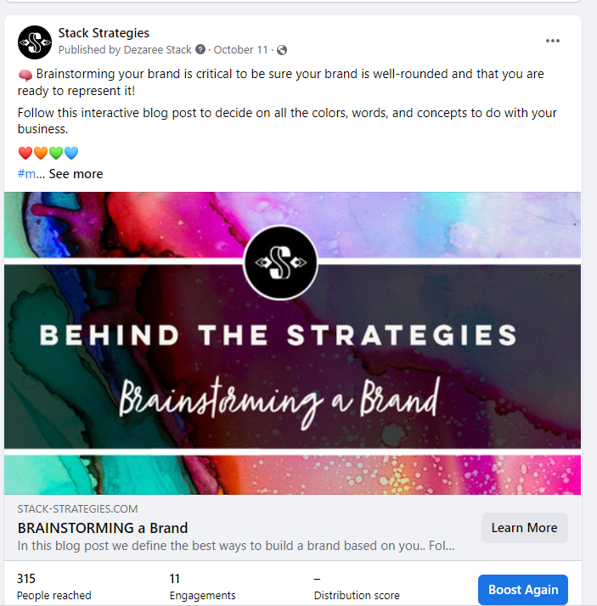
Links to content can take the place of graphics and pictures or be used in addition to graphics and images. Links can redirect to:
Your website
Lead generation
Your blog
Other people’s blog
Reliable resources such as news outlets, articles, and other media
Save links in your content chart to save time later.

Slide 33

Hashtags are content tags that identify topics your posts relate to and lead people interested in those topics to your posts.
Use hashtags other people would follow. Avoid using hyper-specific tags such as “#travelingtipsforoldertravelers.” They’re confusing to read and not very likely to be searched. Rather, use tags like #travel, #traveltips, #vacation, and other short phrases relating to your topic.
Check your spelling. If a hashtag is misspelled, it will not show up when the correctly spelled tag is searched. For example, #travel will have millions of posts. #Travle will not.
Use branded hashtags. Branded hashtags are a great way to draw brand attention to your page, possibly landing you brand deals and more.

Slide 34
Personally, I like to gather content assets and orgainze them ahead of time for markeitng. Here's some things I do to organize content:
1. Download stock photos and save them to your computer or online drive.
2. Create several graphics on different topics when I am feeling very creative.
3. Pre-record or pratice videos and talking points.
4. Save links in your content chart for easy copy-and-pasting.
5. Pre-write hashtags in your content chart for easy copy-and-pasting.
Notes:
Remind the class to save the chart as they made changes!

Slide 35
Developing a Post Plan per Week
4-6 Posts | 8-12 Posts | 12-15 Posts
1-2 posts - business product/service 1 post – hashtag or holiday 1 post – connection or conversation 1 post – business about 1 post – educational | 2-3 posts – business product /services 1-2 posts – specialty expertise 1-2 posts – holiday or hashtag 1-2 posts – connection or conversation focused 1-2 posts – educational 1 post – business about (optional) 1 post – inspirational | 3 posts – business product or services 2-3 posts – educational 2 posts – specialty expertise 2 posts – connection or conversation 1-2 posts – holiday or hashtag 1-2 posts – website links 1 post – business about 1 post – inspirational
Notes:
Remind the class to save the chart as they made changes!

Slide 36
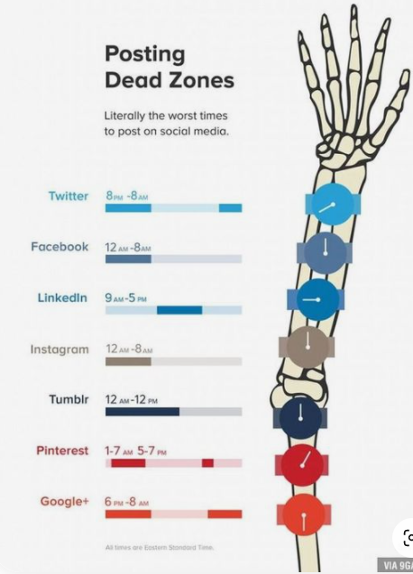
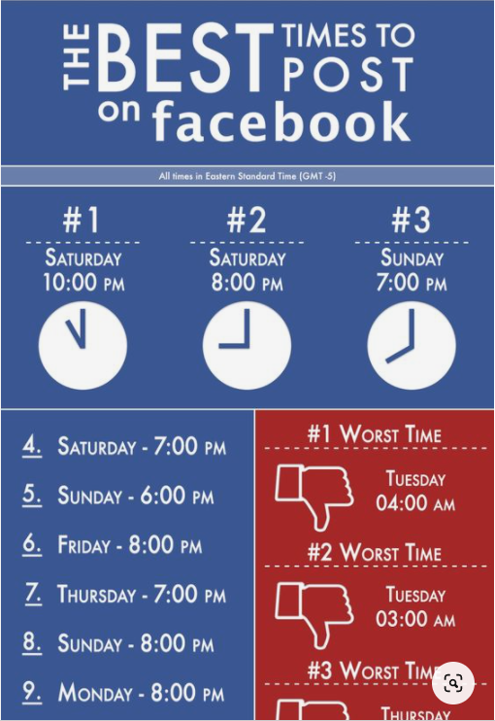
Timing
is
Everything!
Notes:
Remind the class to save the chart as they made changes!

Slide 37
15 minutes

Slide 38

Stories on Facebook & Instagram

Slide 39


Let's practice making cooler content using stories!
Let's go right to Instagram to practice.
Insert a photo and move it
Tag a page or location
Use stickers of GIFs
Make a boomerang
Add a link
Notes:
Remind the class to save the chart as they made changes!

Slide 40

We can schedule stories through Business Suite.
Advantages of Scheduling
Advantages of Not Scheduling
Gets it done in advance
Can add up to ten photos at once
Add photos or videos
Some stickers
Instagram features
More personal
More stickers and font options
Option to add link
Notes:
Remind the class to save the chart as they made changes!

Slide 41

Running Ads on Facebook & Instagram

Slide 42

Reviewing Engagement

Slide 43

Goals are nothing wihtout a solid plan.

Slide 44


Scheduling time on the calendar is the only way to get things done.
On a weekly basis:
Create Posts
Develop Content
On a daily (or so) basis:
Create Stories
Run Ads
Save content
On a monthly basis:
Review Analytics
Notes:
Remind the class to save the chart as they made changes!

Slide 45
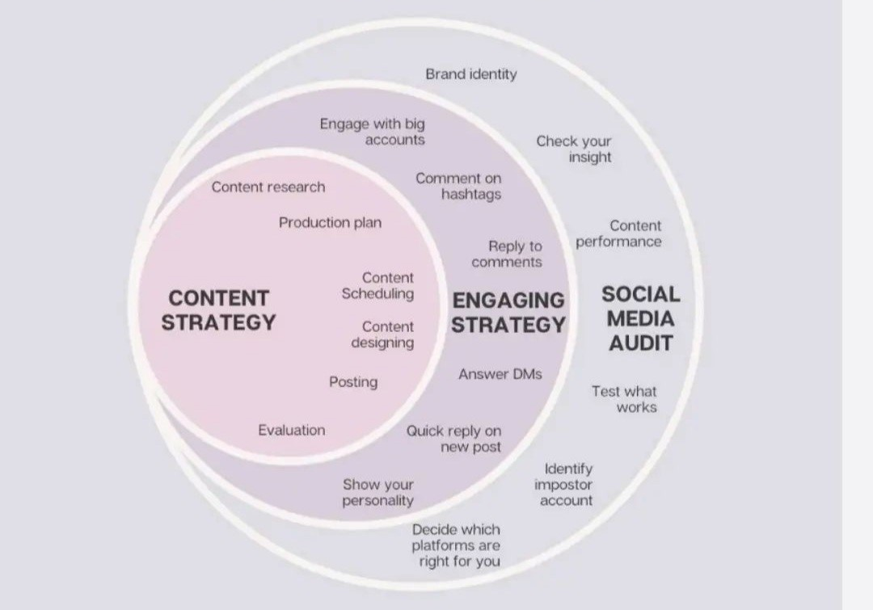
Notes:
Remind the class to save the chart as they made changes!

Slide 46

Open discussion for marketing topics.

